Slide 1
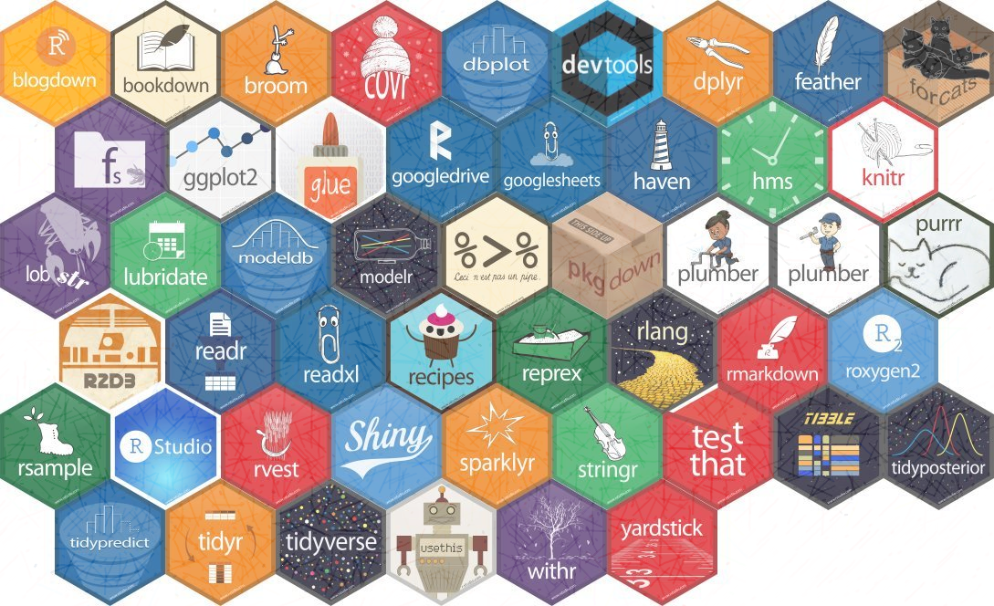
Advanced modelling IN R
The potential of R and ML in healthcare
Gary Hutson – Head of Data Science / AI – Draper and Dash

Slide 2
Ai or ml – what is the difference
Definition:
Artificial Intelligence (AI) – “It is the study of how to train machines or computers, in order to do things, which at present humans can do better”
Machine Learning (ML) – “the study of computer algorithms that allow computer programs to automatically improve through experience”

Slide 3
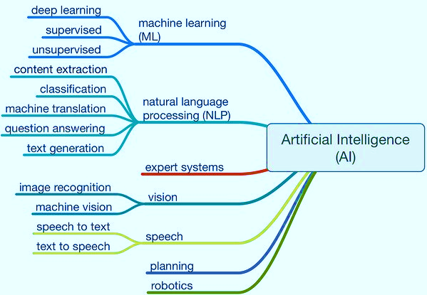
What makes up ai?

Slide 4

Types of ml and uses

Slide 5


R vs python – the grand data scientist debate
R | Python
Supervised and Unsupervised Learning | Supervised and Unsupervised Learning
Natural Language Processing aided by Tidytext and tm packages | Natural Language Processing
Deep Learning – packages such as H2O, Keras and MxNet | Deep Learning and Computer vision (OpenCV was designed for Python and R does not have a suitable
Data mangling, wrangling, encoding, cleaning and visualization | Data mangling, wrangling, feature encoding, cleaning and visualization
 | Reinforcement Learning – agent vs reward Q Learning models
 | Object orientated platform is easier to use than S3 and S4 in R.

Slide 6

How can ml be used to aid in decision making and challenging organizational issues?

Slide 7
Application in healthcare and beyond
Some example:
Decision Impact Support Tools – supervised learning models are increasingly being used to look at the relationship multiple variables have on a specific outcome measure or measures – examples are admission prediction tools, readmission avoidance tools, LOS prediction tools, mortality predictors, stranded patient predictors, COVID-19 probabilistic estimators based off similar patient demographics and characteristics, etc.
Imaging augmentation tools – computer vision algorithms utilized to detect irregular scans i.e. presence of certain conditions using convolutional deep learning
Deep neural networks will be used to expose hidden relationships and underlying features in all activity, access, diagnostic and other hospital datasets to drive more accurate and precise predictions
Reinforcement learning will be used to optimize prescription regimes and will be able to work out the reward (effect) associated with every patient in clinical trials

Slide 8
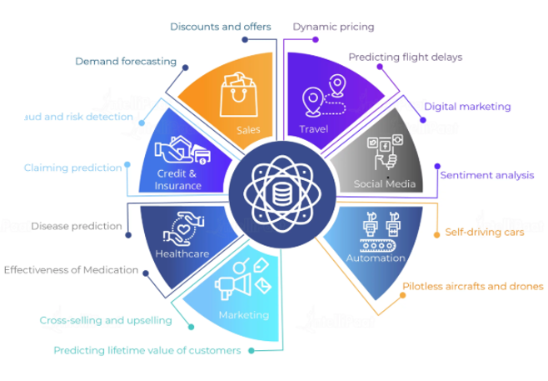
Wider usage

Slide 9
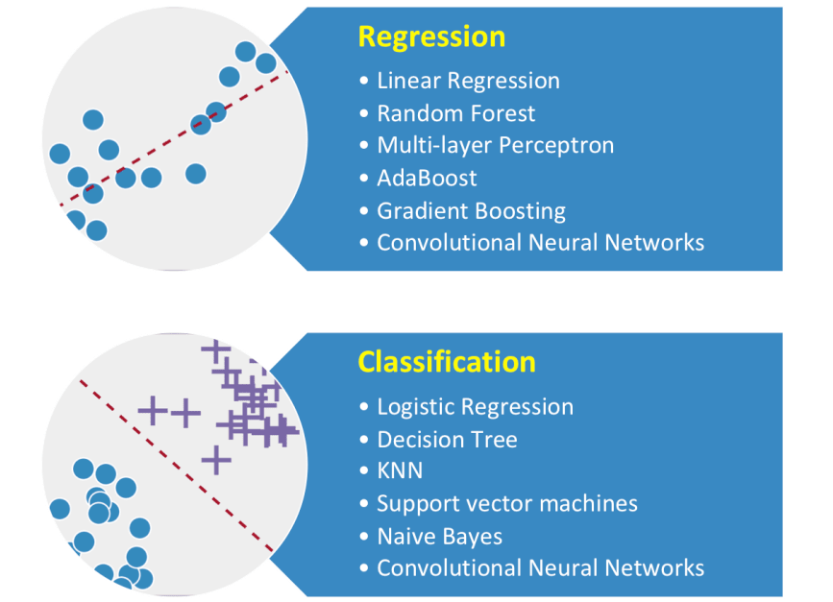
supervised learning

Slide 10
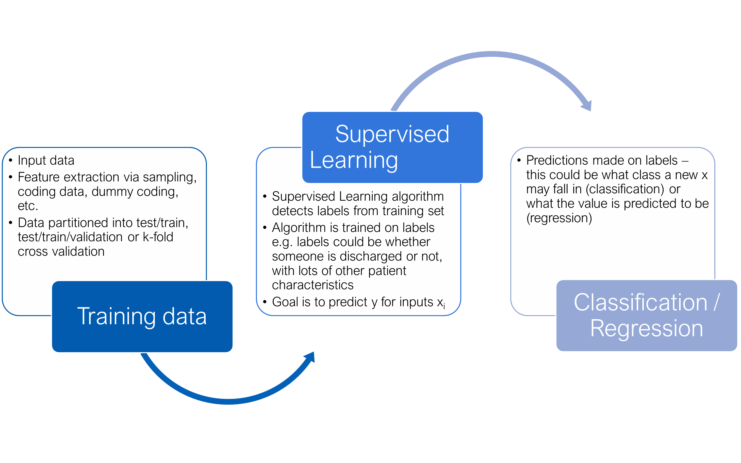
Supervised learning – what is it?

Slide 11

Let’s build a ml model with caret

Slide 12
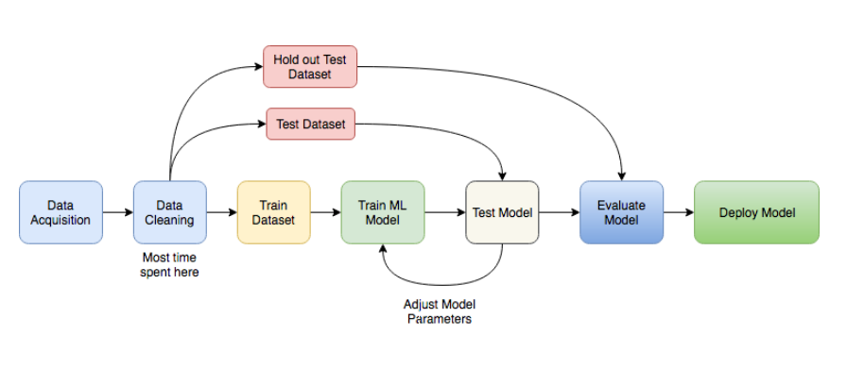
ML process

Slide 13
Classification modelling

Slide 14
Classification imbalance

Slide 15
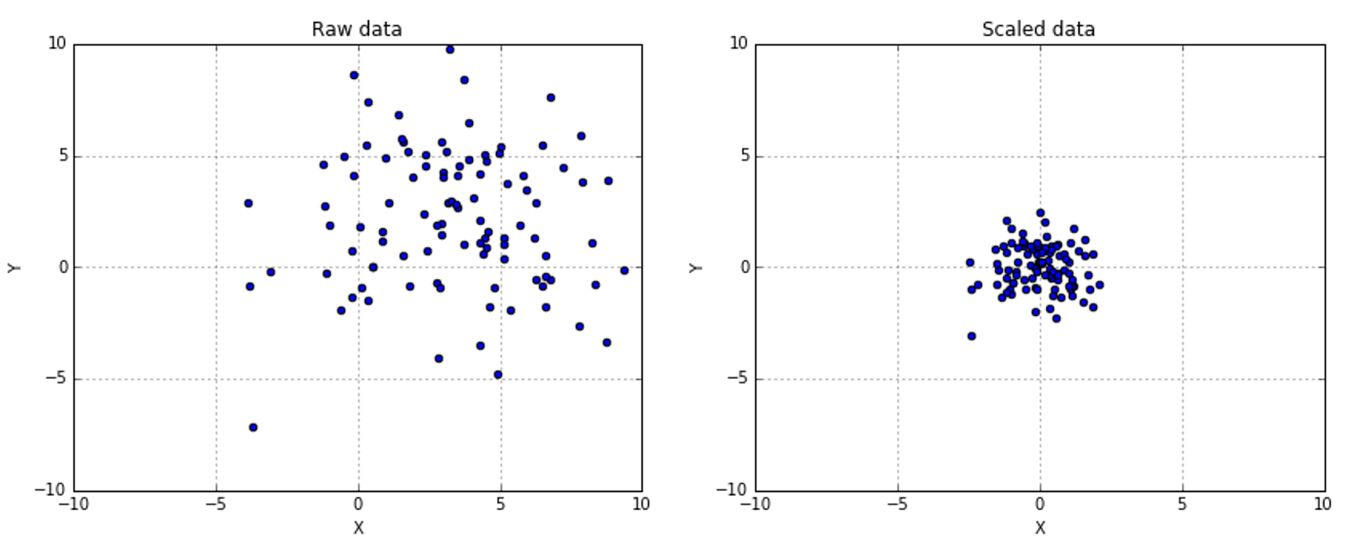
DATA scaling

Slide 16

DATA partitioning and resampling

Slide 17


Algorithm logic and intuition

Slide 18



CARET

Slide 19

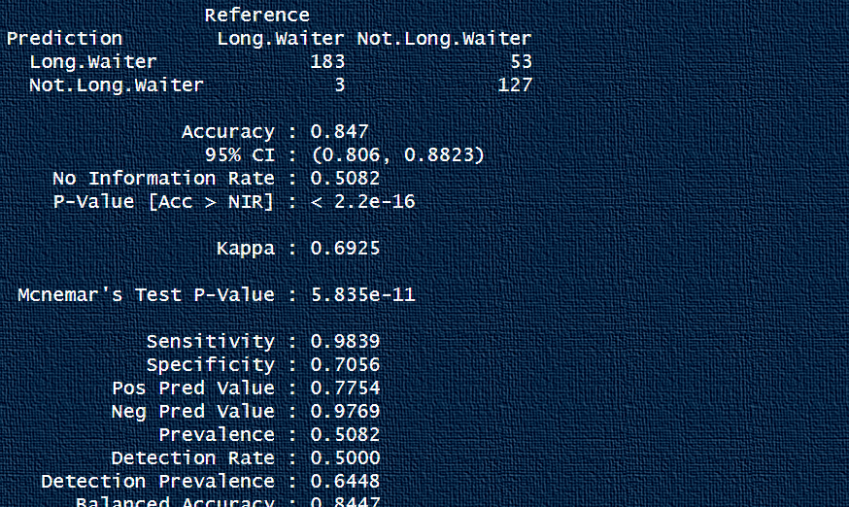
Confusion matrices
https://draperanddash.com/machinelearning/confusion-matrices-evaluating-your-classification-models/

Slide 20
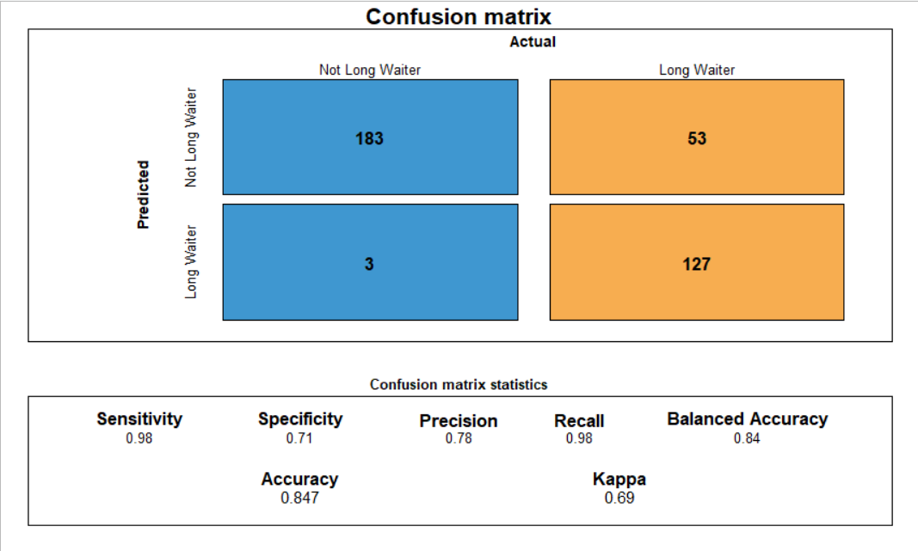
CONFUSION MATRIX

Slide 21
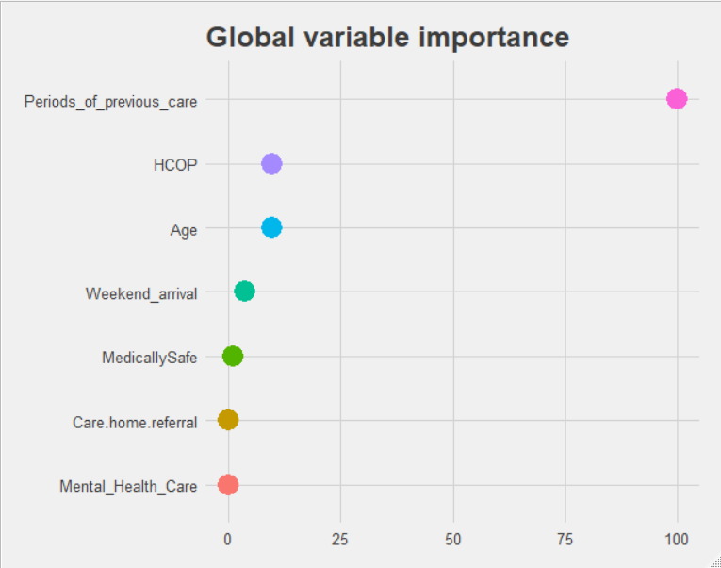
Global variable importance

Slide 22
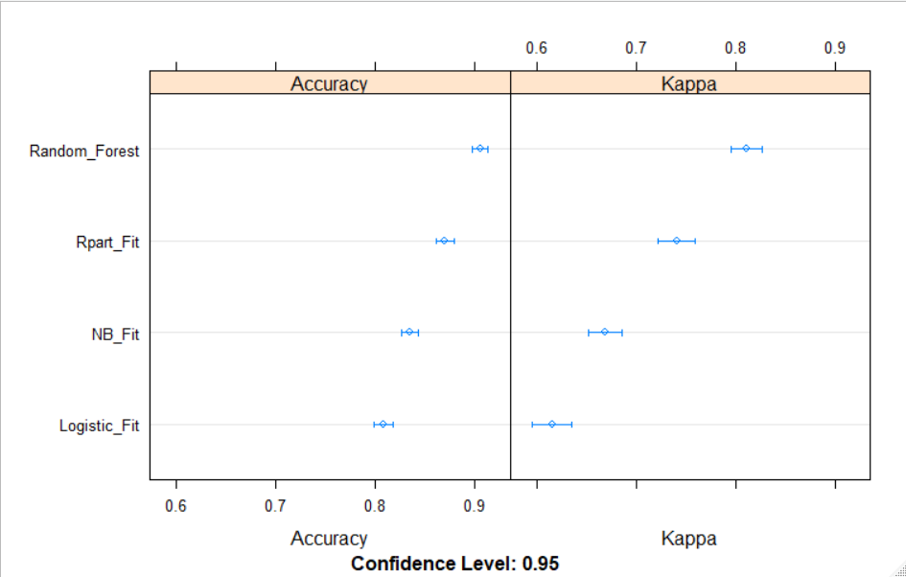
Algorithm benchmarking

Slide 23
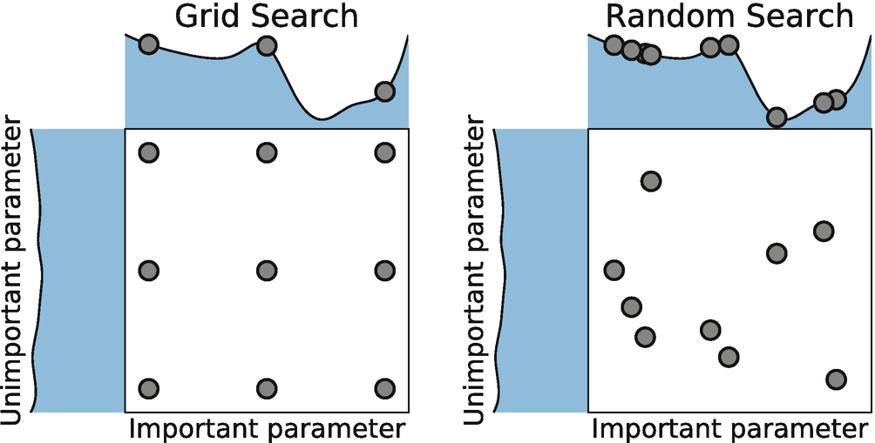
Hyperparameter tuning – random and grid search

Slide 24
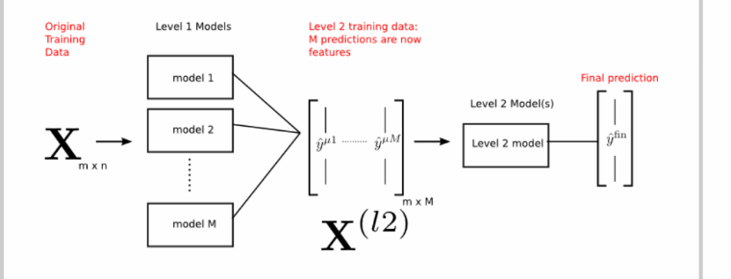
Stacking ensemble algorithm

Slide 25
Regression modelling

Slide 26
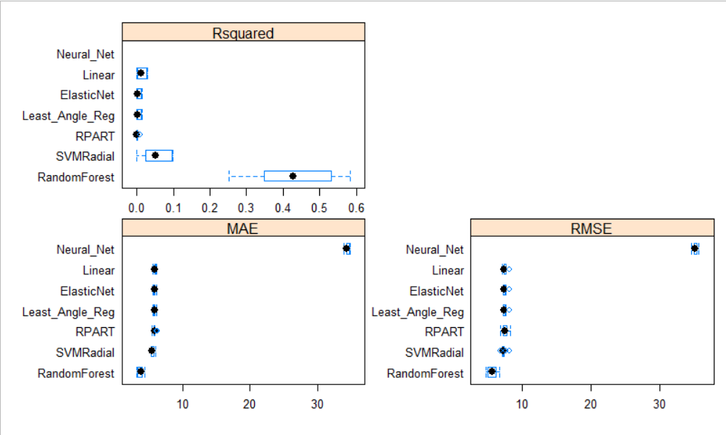
Regression benchmarking

Slide 27
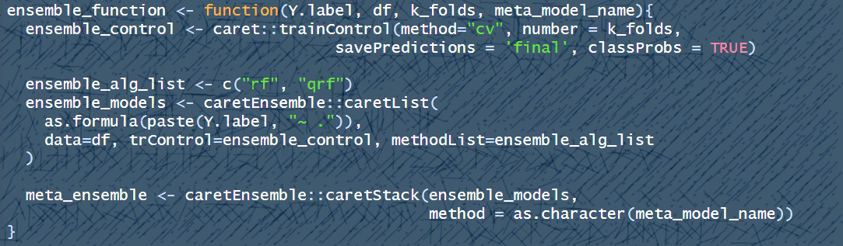
Regression ensembling function

Slide 28
Deploying r model into production and making predictions

Slide 29
Why caret?
Deep learning can be more effective – packages such as Keras / Tensorflow, H2O and MxNet being the market leaders. However, most NHS systems do not have sufficient enough servers to take the processing load of a 3 layer model consisting of 128, 256, 128 node model
CARET is the right fit between serious ML and applications that can be more useful on smaller datasets for supervised ML
TidyModels vs CARET – whilst Max Kuhn and his team are developing this out recipes and parsnip – these packages have only 25% of all the algorithms listed under CARET. Max admits himself that this is not a replacement to CARET and it is still worth using CARET for ensembling and ML, as this will not be deprecated for a long time

Slide 30
Links to other cool work
Feature importance – I have identified global feature importance in the previous slides, but for local feature importance – LIME is a great summary tool to look at a local (patient) level: https://cran.r-project.org/web/packages/lime/vignettes/Understanding_lime.html
Parsnip and recipes: let Max explain as he creates these awesome tools for R:https://www.youtube.com/watch?v=ZFTjroC8bTg
Speeding up ML models in CARET: https://hutsons-hacks.info/threading-and-caret-buring-your-cpu-to-improve-model-training-speed
Deploying a model RDA files for use in production side predictions: https://draperanddash.com/machinelearning/deploying-a-trained-supervised-ml-model/

Slide 31




InterestED in deep learning with and with R?

Slide 32




Signing off

